Slide 1
How active is your fund manager?
a new measure that predicts performance
author: K.J. Martijin Cremers & Antti Petajisto
presenter: Judy Zhu

Slide 2
Example:
the T. Rowe Price Small Cap fund is a pure stock picker, which hopes to generate alpha with its stock selection within industries, but it simultaneously aims for high diversification across industries;
the Morgan Stanley American Opportunities fund is a “sector rotator,” which focuses on actively picking entire sectors and industries that outperform the broader market while holding mostly diversified (and thus passive) positions within those sectors;
The tracking error of the diversified stock picker is substantially lower than that of the sector rotator, suggesting that the former is much less active. But this would be an incorrect conclusion!!

Slide 3
catalog
01 definition and measures of active management
02 empirical methodology
03 results:active management
04 results: fund performance

Slide 4
01
definition and measures of
active management

Slide 5
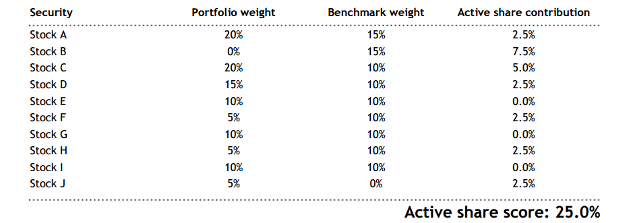
Definition and Measures of Active Management
passive management: it consists of replicating the return on an index with a strategy of buying and holding all (or almost all) index stocks in the official index proportions.
active management: any deviation form passive management
1. tracking error:
modified:
2. active share

Slide 6
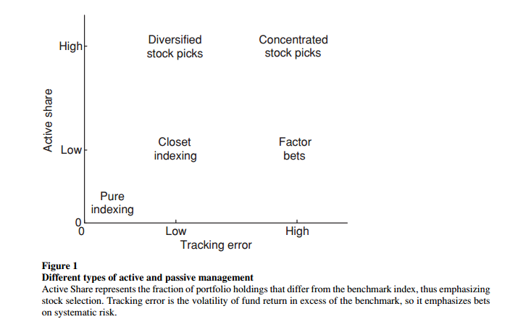
Definition and Measures of Active Management
3.Combining Active Share with tracking error
active management is not a one-dimensional concept :
stock selection :attempting to pick outperforming stocks relative to a benchmark portfolio with similar exposure to systematic risk-----active share
factor timing: taking time-varying positions in broader factor portfolios according to the manager’s views of their future returns.--------tracking error

Slide 7
02
Empirical Methodology

Slide 8
Empirical Methodology
data on stock holdings: from the CDA/Spectrum mutual fund holdings database maintained by Thomson Financial.The database is compiled from mandatory SEC filings as well as voluntary disclosures by mutual funds;
benchmarks for the funds:we include essentially all indexes used by the funds themselves over the sample period. We have a total of nineteen indexes from three index families: S&P/Barra, Russell, and Wilshire;to determine the benchmark index for each fund, We compute the Active Share of a fund with respect to all nineteen indexes and assign the index with the lowest Active Share as that fund’s benchmark;
data on return:Monthly returns for mutual funds are from the CRSP mutual fund database. Monthly returns for benchmark are from S&P, Russell, and Ibbotson Associates, and all of them include dividends;
sample selection: our final sample consists of 2,647 funds in the period 1980–2003. For each year and each fund, the stock holdings are reported for an average of three separate report dates (rdate); the total number of such fund-rdate observations in the sample is 48,354.

Slide 9
03
results:active management

Slide 10
03
02
01
investigate the determinants of Active Share in a more general multivariate case
discuss the time-series evolution of active management
cross-sectional analysis of fund characteristics for various types of funds

Slide 11
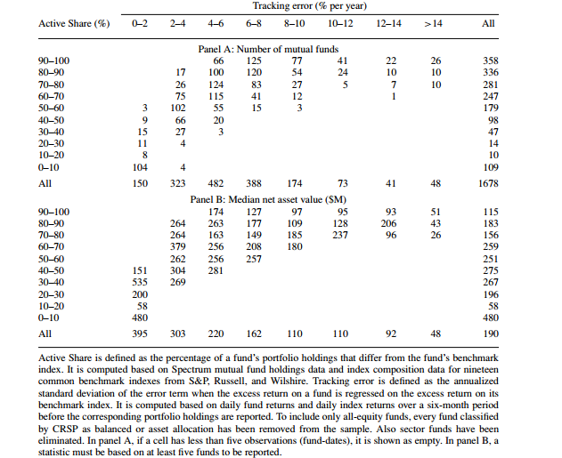
results:active management
1.Two-dimensional distribution of funds
distinguishing between the two dimensions of active management is also empirically important if we want to understand how much each fund engages in stock selection and factor timing .

Slide 12
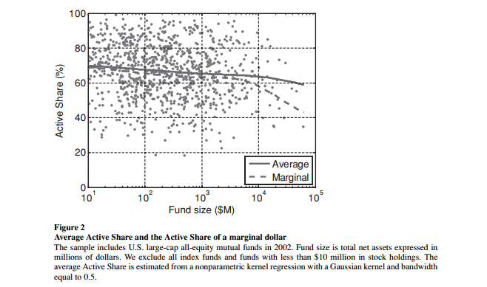
results:active management
Are smaller funds more active?

Slide 13
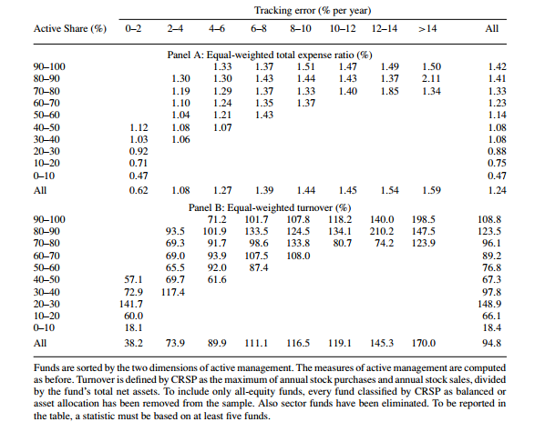
results:active management
Fees and active management & portfolio turnover
The funds with the highest Active Share charge an average expense ratio of 1.42%;
Index funds clearly have the lowest expense ratios,which is 0.47 ;
Almost all non-index fund groups have roughly comparable turnover averages, while the index funds clearly stand out with their lower turnover;
Tracking error turns out to predict turnover better than Active Share;

Slide 14
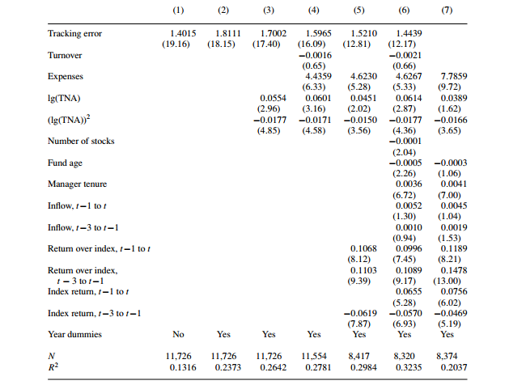
results:active management
2. explain active share

Slide 15
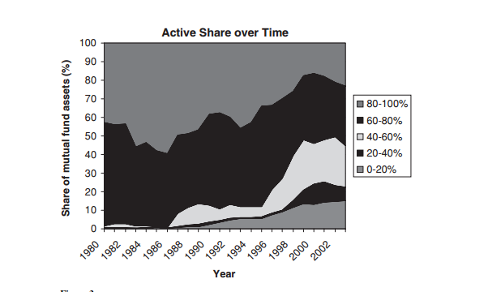
results:active management
3. active management over time
a clear time trend toward lower Active Share:
fund assets with Active Share greater than 80%: 42.8% --- 23.3%
index funds :
1%--15%

Slide 16
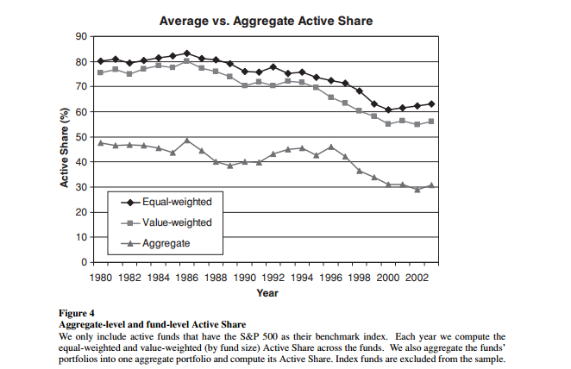
results:active management
3. active management over time
The figure shows that about one-half of those active positions actually cancel out each other. And in the most recent years, the aggregate value has been about 30% out of a fund-level average of 55–60%. This means that the mutual fund sector as a whole gives investors an Active Share of no more than 30%. The remaining active bets are just noise between funds, which will not contribute to an average alpha.
This helps us understand why the average mutual fund underperforms net of fees: given their low aggregate Active Share, they would have to display considerable skill in their aggregate active bets to fully overcome their fees and expenses.

Slide 17
04
results:fund performance

Slide 18
results:fund performance
why focus on the benchmark-adjusted performance measures?
Example: individual indexes such as the S&P 500 have economically and statistically significant annual four-factor alphas of 1.08% (t = 2.72) . Yet it would be inappropriate to attribute the 1.08% alpha to the “skill” of a purely mechanical S&P 500 index fund.Adjusting fund returns for the benchmark index return effectively recalibrates the alpha of the benchmark to zero. This seems reasonable, as a passive benchmark index such as the S&P 500 should almost by definition have a zero alpha.
1.mutual funds are legally required to declare a benchmark index, and the purpose of an active manager is to beat that benchmark.
2.the benchmark indexes are easily tradable portfolios—there are a number of products such as ETFs, index mutual funds, and various derivative contracts that allow investors to tailor their exposure to a particular index at a low cost.

Slide 19
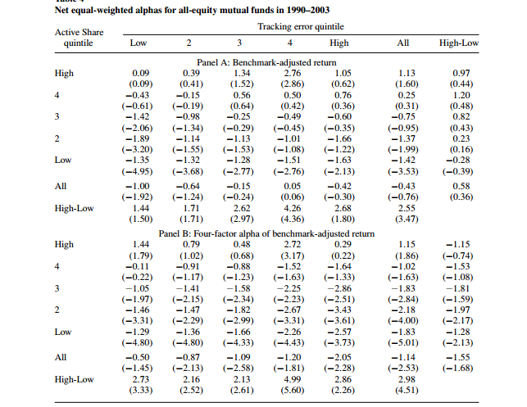
results:fund performance
1.Active Share versus tracking error
the average fund loses to its benchmark index by 0.43% per year, and the loss increases to 1.14% under the four-factor model;
Active Share does improve fund performance relative to the benchmark. The difference in benchmark-adjusted return between the highest and lowest Active Share quintiles is 2.55% per year (t = 3.47), which further increases to 2.98% (t = 4.51) with the four-factor model; The difference in abnormal returns is positive and economically significant within all tracking error quintiles.

Slide 20
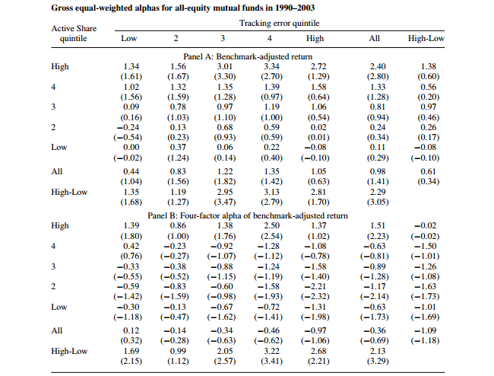
results:fund performance
The evidence in these two panels suggests that the funds with low ActiveShare and high tracking error tend to do worst, which implies that factor bets tend to destroy value for fund investors.
Closet indexers (low Active Share, low tracking error) also exhibit no ability and tend to lose money after fees and transaction costs.
The best performers are concentrated stock pickers (high Active Share, high tracking error), followed by diversified stock pickers (high Active Share, low tracking error). Both groups appear to have a stock-picking ability, and even after fees and transaction costs,the most active of them beat their benchmarks.

Slide 21
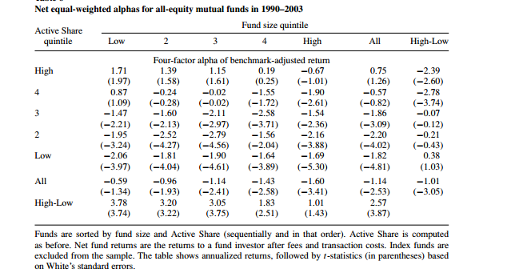
results:fund performance
2.fund size and active share
It is especially for the smaller funds that the highest Active Share funds exhibit economically significant stock-picking ability: their stock picks outperform their benchmarks by about 3.8% per year, net of fees and transaction costs .

Slide 22
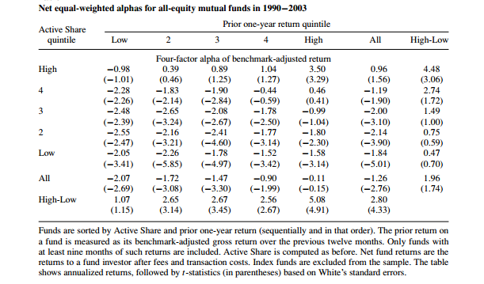
results:fund performance
3.Active Share and performance persistence
remarkable persistence!
From an investor’s point of view, the prior one-year winners within the highest Active Share quintile seem very attractive,with a 3.50% (t = 3.29) annualized alpha with respect to the four-factor model.

Slide 23
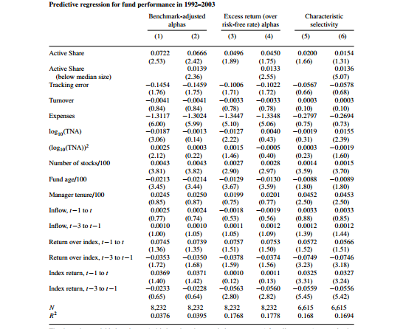
results:fund performance
4.fund performance in a multivariate regression
Active Share comes up as a highly significant predictor of future alpha;
tracking error produces a small negative effect on future performance, which is marginally statistically significant;
total net asset and expenses are also significant predictors of returns;
the relation between Active Share and performance is stronger for smaller funds;

Slide 24
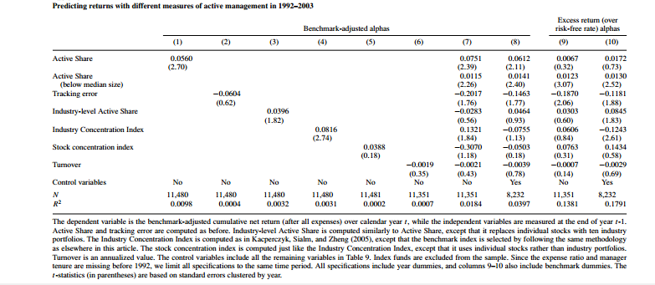
results:fund performance
5.comparison of all measures of active management

Slide 25
Thank you!

